Slide 1
Student Report Management System
Submitted in the partial fulfillment for the award of the degree of
BACHELOR OF ENGINEERING
IN
Computer Science Engineering
Submitted by: -
Shivam Kumar-21BCS3486
Kaduluri Harshith-21BCS3235
Nikita Sah-21BCS3134
Jettiboina V K Swamy Naidu-21BCS3376
Under the Supervision of: -
Parveen Kaur
Department of CSE
DISCOVER . LEARN . EMPOWER

Slide 2
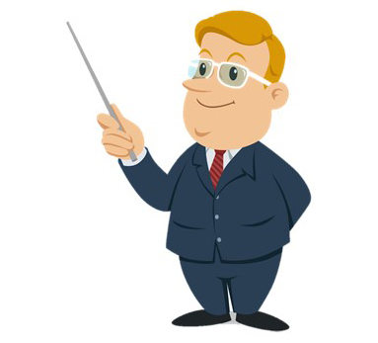

Outline
1.
Introduction to Project
2.
Problem Formulation
3.
Objectives of the work
4.
Tools Platform and Language
5.
Results and Outputs
6.
Conclusion
7.
Future Scope
8.
References

Slide 3
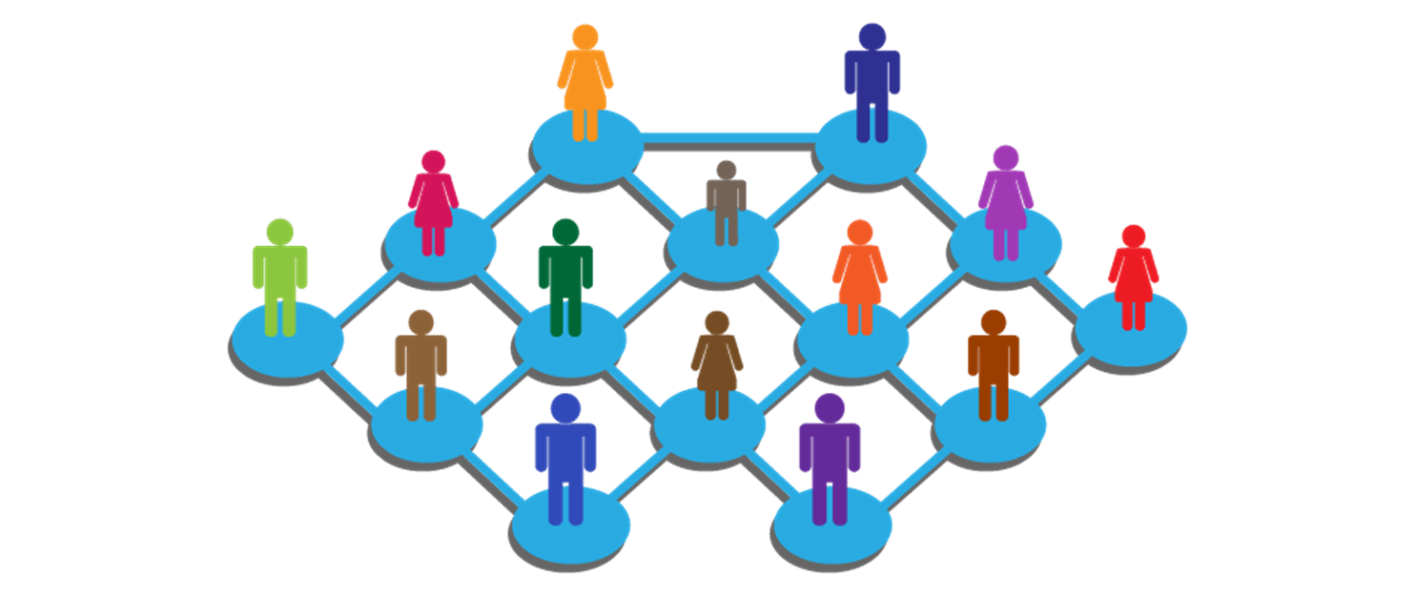


What is SRMS?
Student Report management system is a distributed application developed to maintain the details of student report in any school.
It maintains the information about the students academic performance.
This software allows the administrator to edit students report, add new students, transfer/promote/terminate students. Each student in the database is associated with a position can be added and edited when need arises.
This system brings about an easy way of maintaining the details of students report in any schools. It is simple to understand and can be used by anyone who is not even familiar with simple students’ system.
It is user friendly and just asks the user to follow step by step operations by giving easy to follow options.

Slide 4

Problem Formulation
Another challenge is that teachers are struggling to watch student’s activities including attendance, leave, discipline,
etc.
Manual handling of students information poses a number of challenges.
The use of paper work in handling some of these processes could lead to human error, papers may end up in the wrong hands and not forgetting the fact that this is time consuming.
The project is aimed at setting up an student information system about the status of the students, the previous class report and the class performance in order to help monitor the performance and achievements of the students through a password protected system.

Slide 5
Objectives
Develop a well-designed database to store student information.
A user friendly front-end for the user to interact with the system.
Easy retrieval of student information.
Ability to sort students queries by school.
Remove details of students no longer reading in the school.

Slide 6
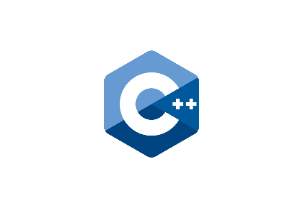


Tools, Platform and Language used
FRONT END:
The programming has been done using the language C++. It is easy to use, efficient and flexible. This language is preferred because one can build a program using this object oriented and platform independent programming.
BACK END:
SQLite database management system is used to store the records of Students. It is easy to use and administer, and it comes with tools and wizards that make it easy to develop applications. The database itself has been redesigned to automatically perform many tuning functions, leaving you free to focus on most important tasks.
PLATFORM USED:
QT creator.

Slide 7
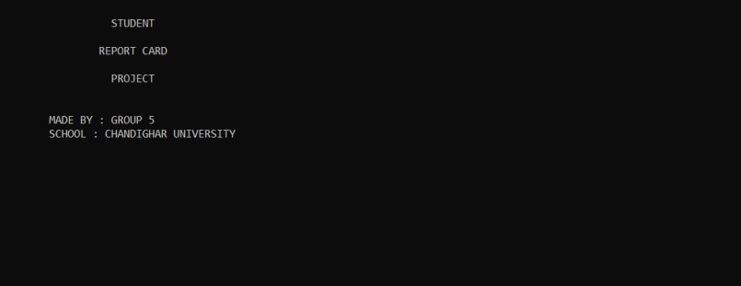
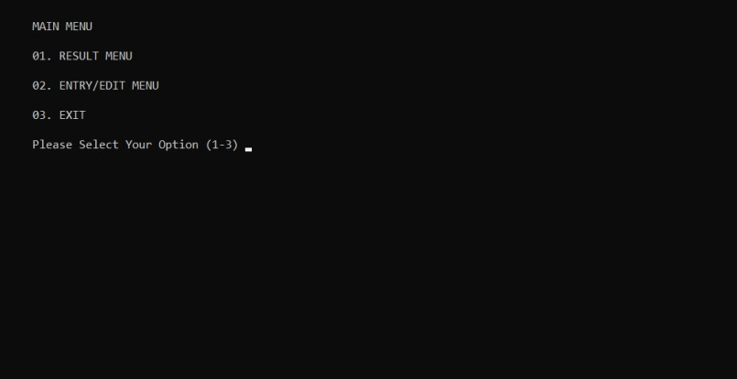
Results and Outputs
1.
2
This is the 1st user-interface that appears on starting of the application.
It includes options name of school.
The window opened is the update request tab, any request when raised from the student end will pop up here. You can see student B has requested for update in details from his end,

Slide 8
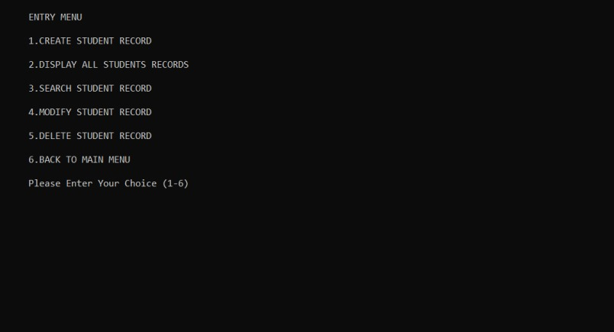
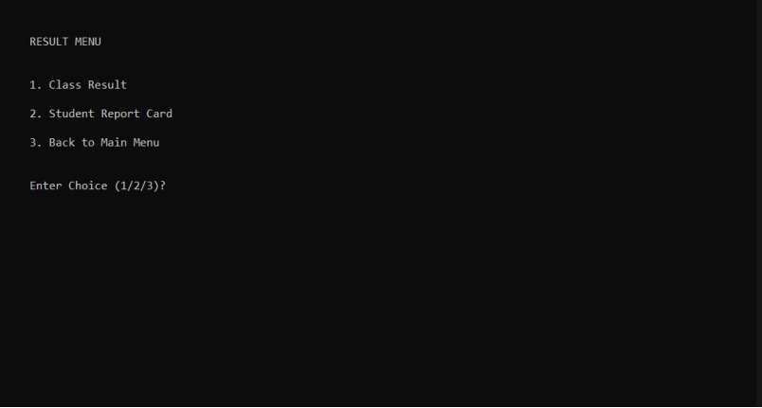
This window shows the option of class and student report card.
3→4
This window shows all option what you want see about student .

Slide 9
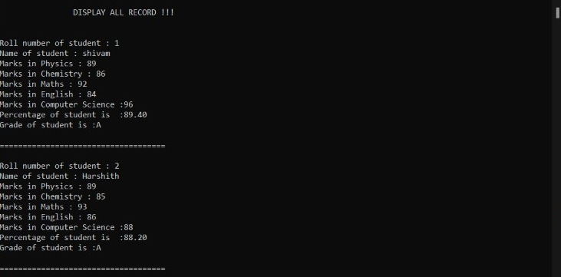
This window shows when you go for any student report card. If the student report card exist.

Slide 10
Conclusion
This Project is developed using Qt creator, C++, VS code and meets the objective of the system for which it has been developed.
This project is used for computerizing the student report management work and aims to reduce the human effort in management of Students report.
The software is capable of easy storage of information related to student through database and thus keeps the record of Students Past and Present details.
Since this project has been designed exclusively as a project, certain complexities that do faced by any real life manual problem like total no. of students, address redundancy etc. are considered in this project. But enhancement to the project can easily be made without changing the current design and programming structure.

Slide 11
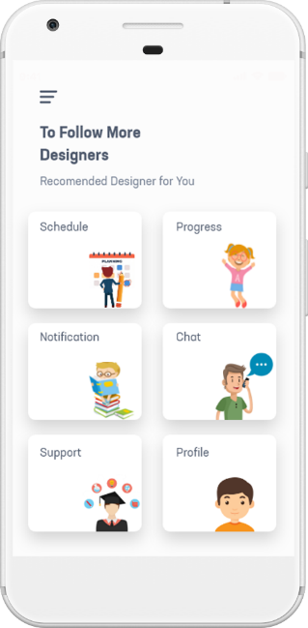

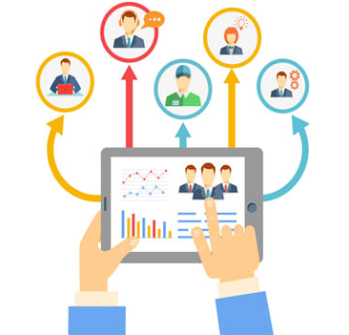
Future Scope
This project is helpful in maintaining the student’s record, keeping the Updated record in the database. In Coming Future it may also focus on calculating the Fees for each employee, their attendance and the no of leaves taken per month/year.
Cloud based system can also be implemented, so that it can be accessed anywhere worldwide with internet connectivity.
It can also be developed as mobile application .

Slide 12


References
YouTube: -​
https://youtu.be/Qc9Smcr-huk​​
https://youtu.be/8CrkNbnnUyM
https://youtu.be/GjzyCUqDMoA
https://youtu.be/ENtlGF2iADI​
https://youtu.be/OrHitqwJu8Q​
https://youtu.be/NJNl4eUa3Xc​
https://youtu.be/NIp6pMtEhC0​
https://youtu.be/6GeOUAV0TaA​
https://youtu.be/Et_bgnJ_Hhg​

